Slide 1

An Explainable AI-Enabled Framework for Interpreting tuberculosis through Chest X-ray using ViT

Slide 2
Agenda
Introduction
Methodology
Working
X-AI
Results

Slide 3

Introduction

Slide 4
Problem Statement
In this era of Artificial Intelligence (AI) its necessary to understand how the deployment of any model work correctly specially in the case of HealthCare where we deal with the detection of Brain Tumor, Tuberculosis and other critical diseases with the help of chest X-ray, CT scan and MRI etc. To explain the working and discuss the major features which contribute in the positive and negative of result, to a laymen is possible through Explainable Artificial Intelligence (X-AI).

Slide 5
What is tuberculosis?
An infectious bacterial disease characterized by the growth of nodules (tubercles) in the tissues, especially the lungs.
Death 1.3 Million people
Effected People 10.6 Million
About a quarter of the global population is estimated to have been infected with TB bacteria.
Reference:
WHO

Slide 6
Symptoms
prolonged cough (sometimes with blood)
chest pain
weakness
fatigue
weight loss
fever
night sweats
Reference:
WHO

Slide 7
Abstract
As the TB is the critical disease and second most killing after COVID, so its necessary to utilize every step to prevent and diagnose this disease immediately. This Machine Learning model helps to predict best result either the given Chest X-ray have positive or Negative TB. For the accurate and fast result we use Vision Transformer (ViT) rather than Convolutional Neural Network (CNN). We obtained the accuracy and confusion matrix with accuracy of 97%. For best explanation of output generated by model we use Explainable Artificial Intelligence (X-AI) models to highlight the effected regions

Slide 8

Methodology

Slide 9
Dataset
For the best interpretation, two datasets are used, we merge the two data sets into three parts.
Dataset Name | Normal | Tuberculosis | Resource
Tuberculosis Chest X-rays (Shenzhen) | 326 | 336 | Kaggle
Tuberculosis (TB) Chest X-ray Database | 3500 | 700 | Kaggle

Slide 10
Dataset Distribution
Training | Testing | Validation
68% | 27% | 5%
Total = 4846

Slide 11
Vision Transformer
The vision transformer used in the project is google/vit-base-patch16-224-in21k. It is a variant of the Vision Transformer (ViT) model pre-trained on the ImageNet-21k dataset. This model divides images into 16x16 patches, processes them as a sequence of tokens using transformer architecture, and is fine-tuned for image classification tasks.

Slide 12

Working

Slide 13
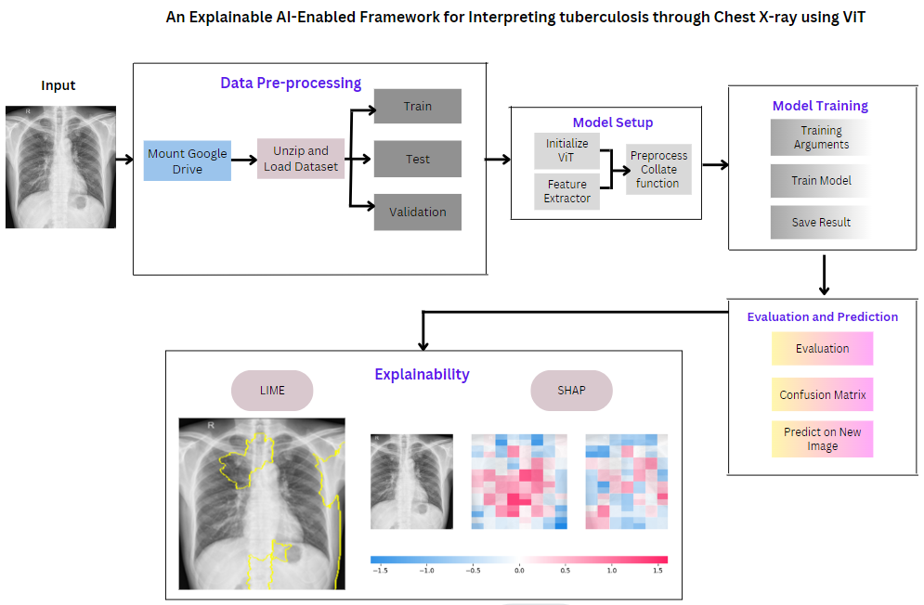
Workflow Diagram

Slide 14
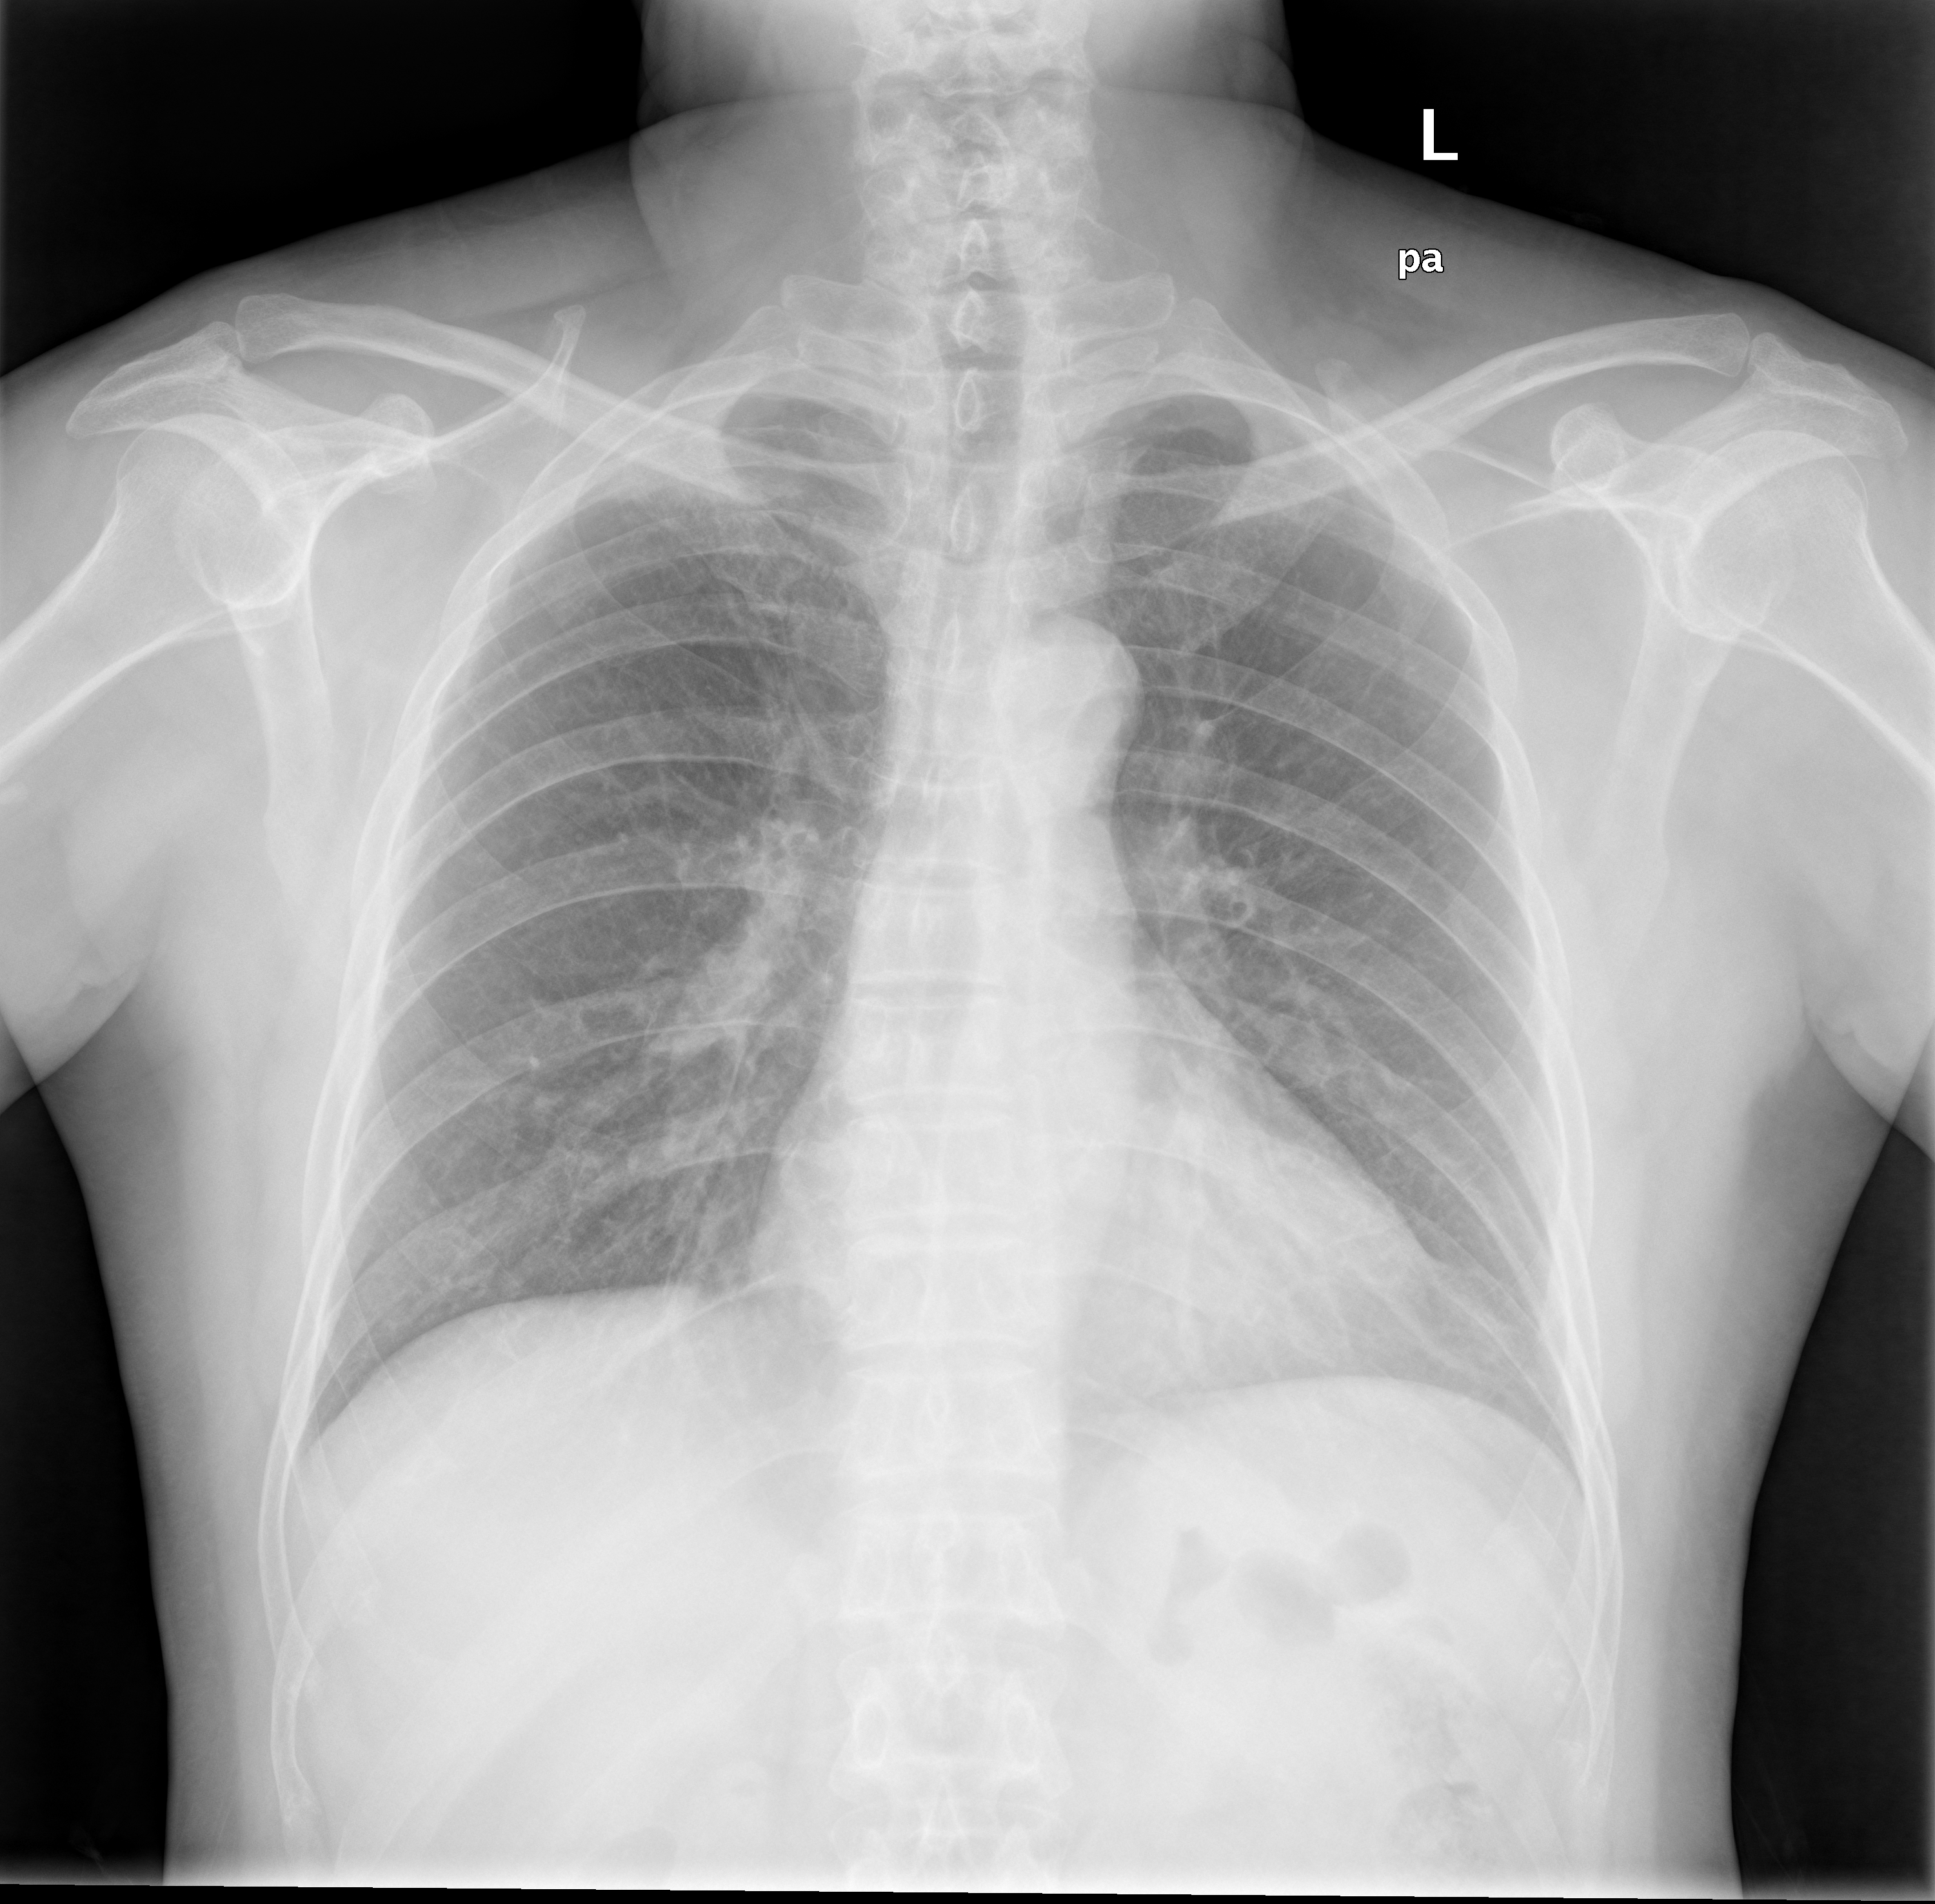
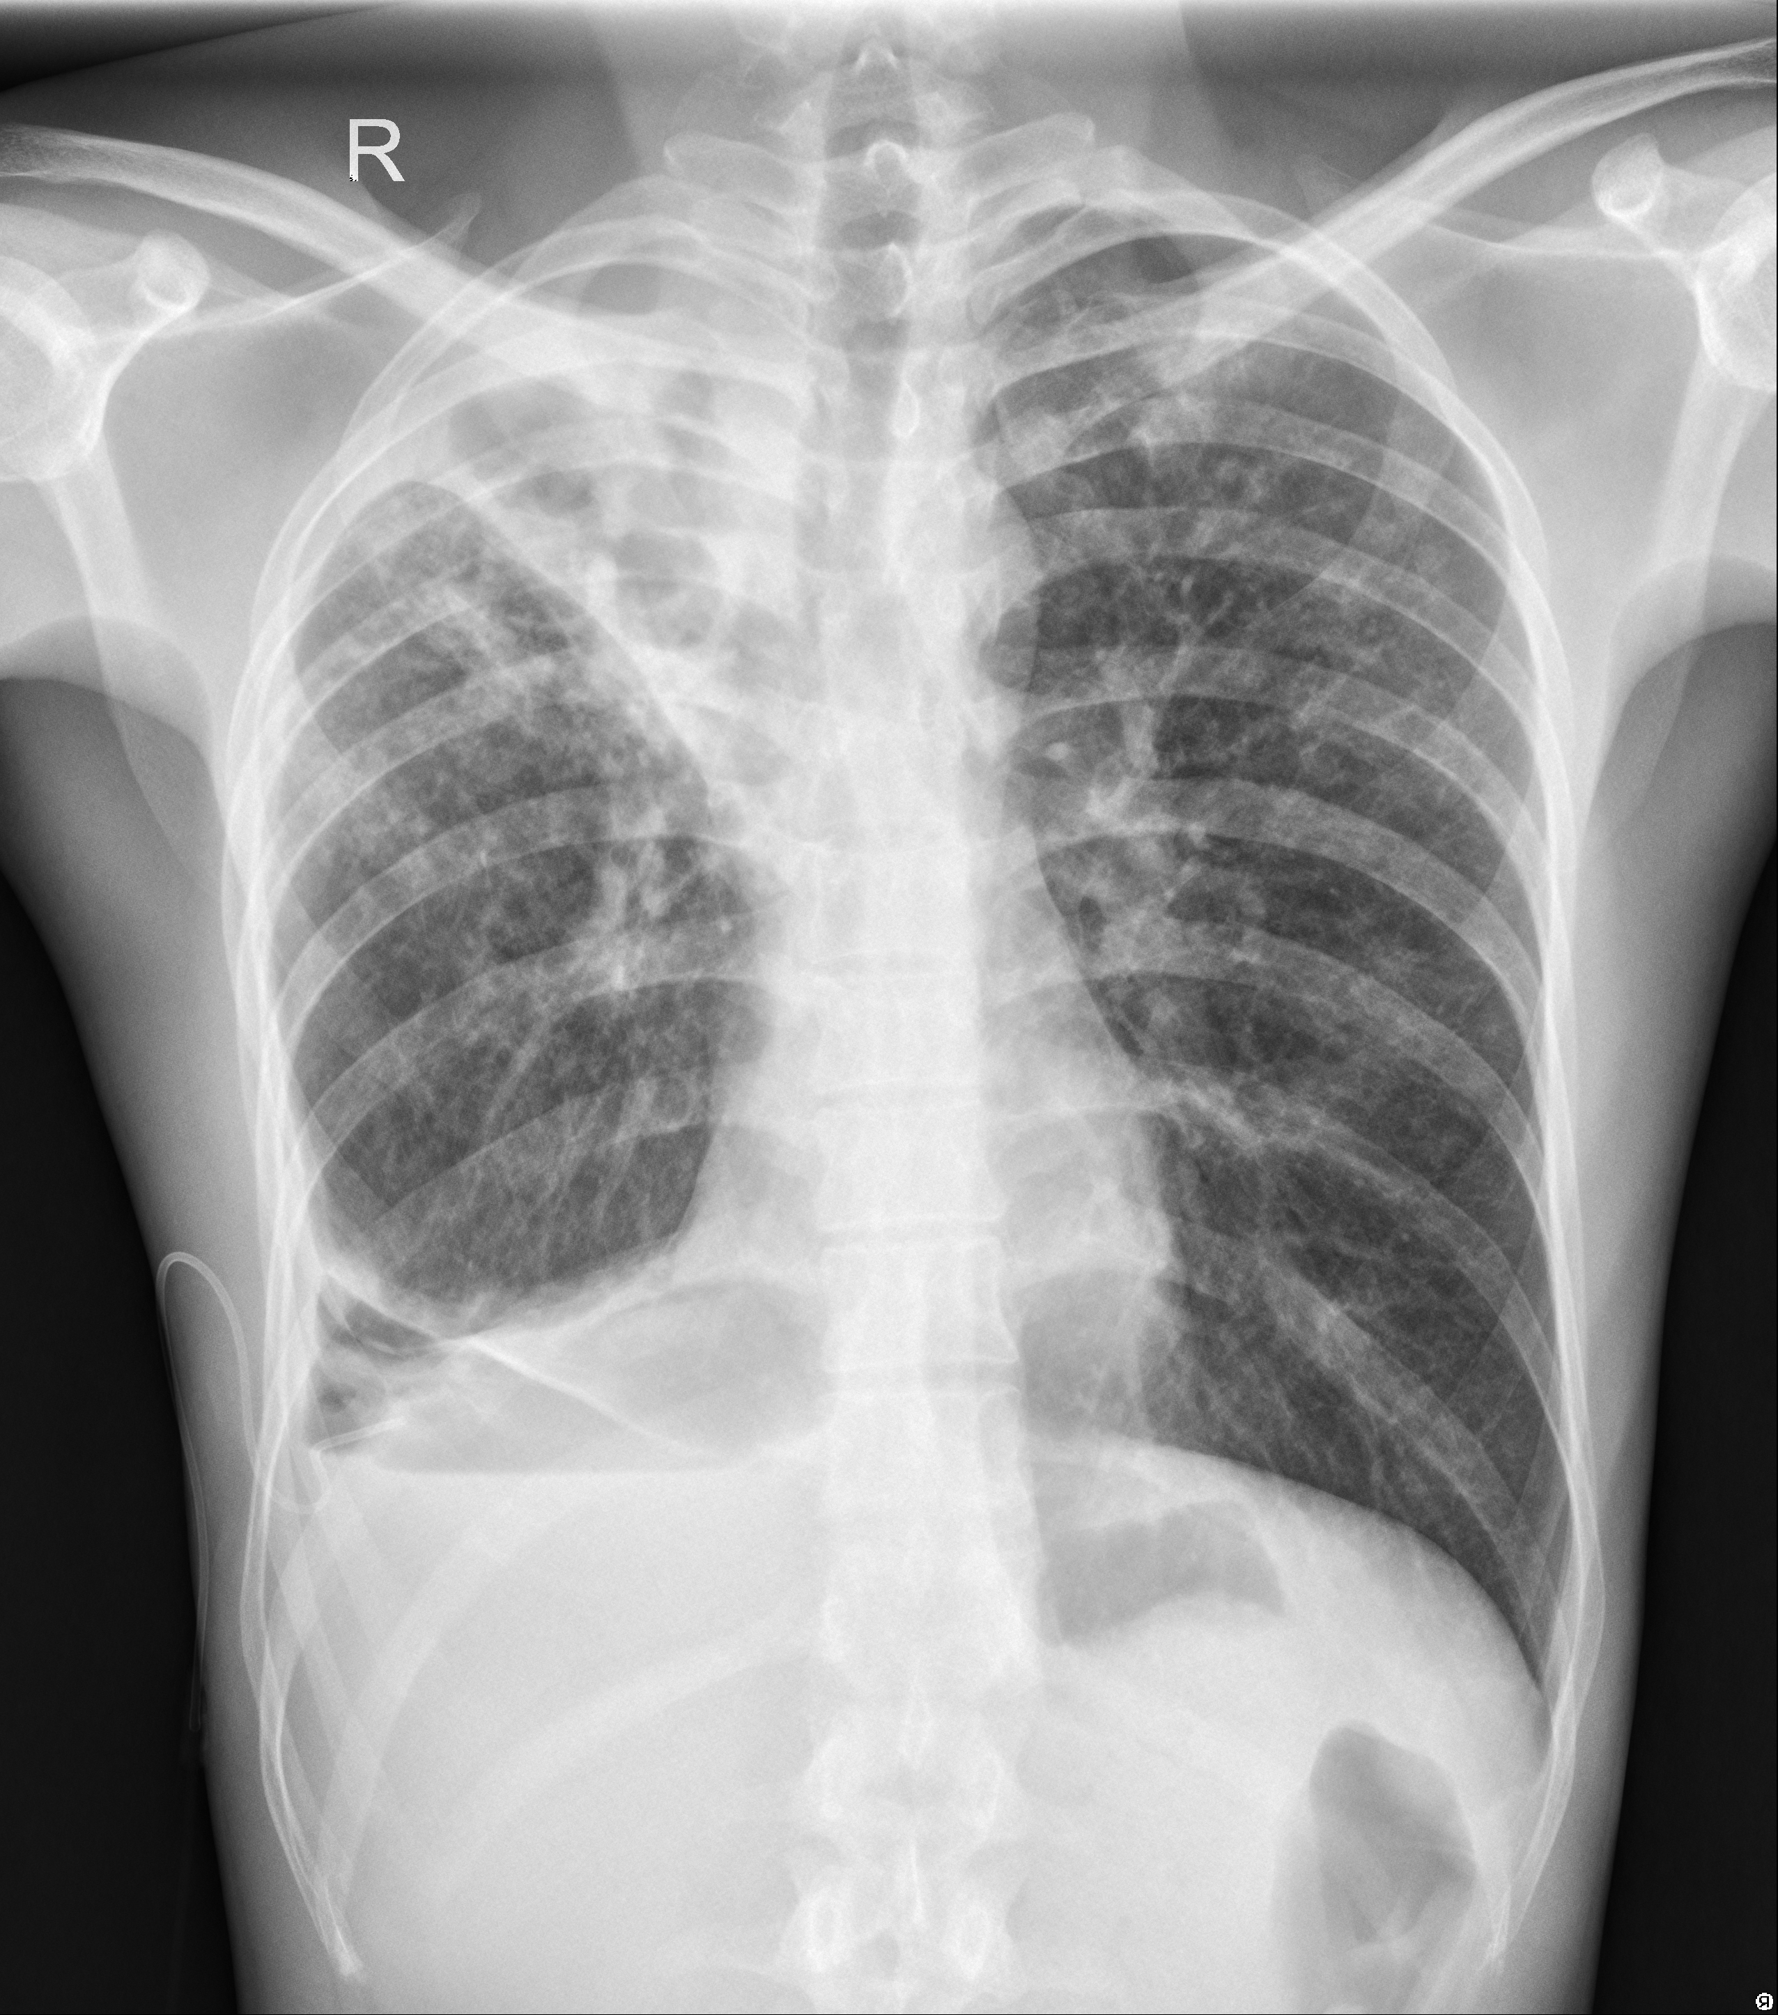
Input
The input is the dataset of images categorized into Normal and Tuberculosis Chest X-ray images which are evaluated through this model.
After train the model, an input CXR is given to the model for testing and which highlight the effected parts of CXR with the contribution of X-AI models like LIME and SHAP if the input CXR is Tuberculosis.
Normal →
← Tuberculosis

Slide 15
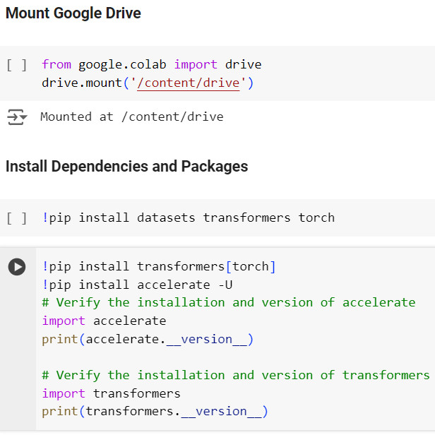
Data Preprocessing
For fast data uploading and save for future use, we upload data in zip format on Google Drive and then mount it in Google Colab.
After that, install the required libraries for load dataset, deep learning framework and vision model.

Slide 16
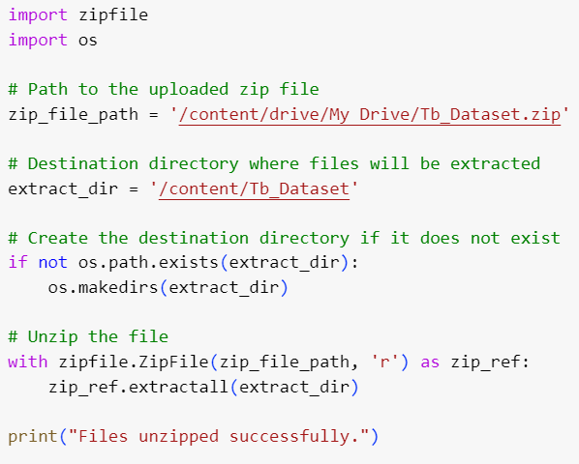
Data Preprocessing
After installation, now we unzip and extract the dataset in Google Colab.

Slide 17
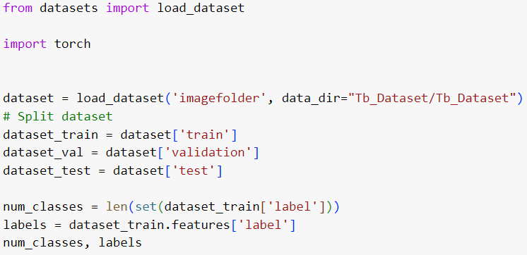
Data Preprocessing
The dataset is divided into subfolders named test, train and test having subfolders named
NORMAL
TUBERCULOSIS

Slide 18
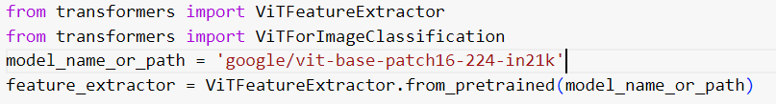
Model Setup
Installation of Vision Transformer (ViT) and Feature Extractor.
Specify the pretrained model named google/vit-base-patch16-224-in21k
The model is pretrained on ImageNet-21k (14 million images, 21,843 classes).
Résolution 224 X 224 pixels.
Reference:
https://huggingface.co/google/vit-base-patch16-224-in21k

Slide 19
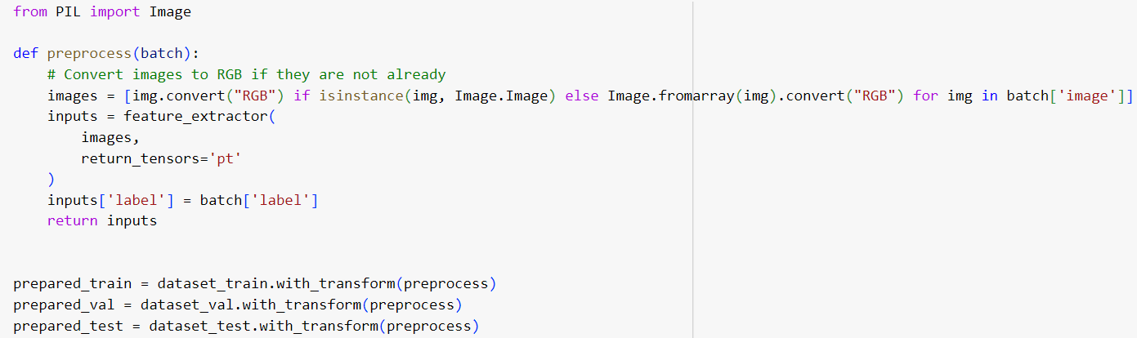
Model Setup
Here we include python imaging library for manipulating images.
The preprocess function converts the Chest X-ray images into RGB (Red, Green, Blue) color and preprocess them using the feature extractor.

Slide 20
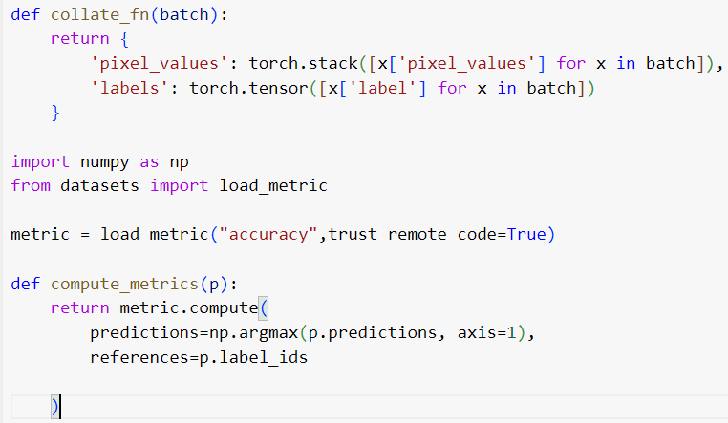
Model Setup
Collate function batches the data together by stacking pixel values and labels.
The compute metrics function compute the accuracy of model’s prediction by comparing to true labels.

Slide 21
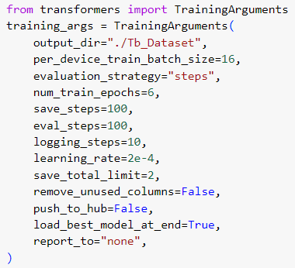
Model Training
Output directory to save the model.
Bach size per device is 16.
When to save the model → after few steps.
Number of times to iterate over the training dataset.

Slide 22
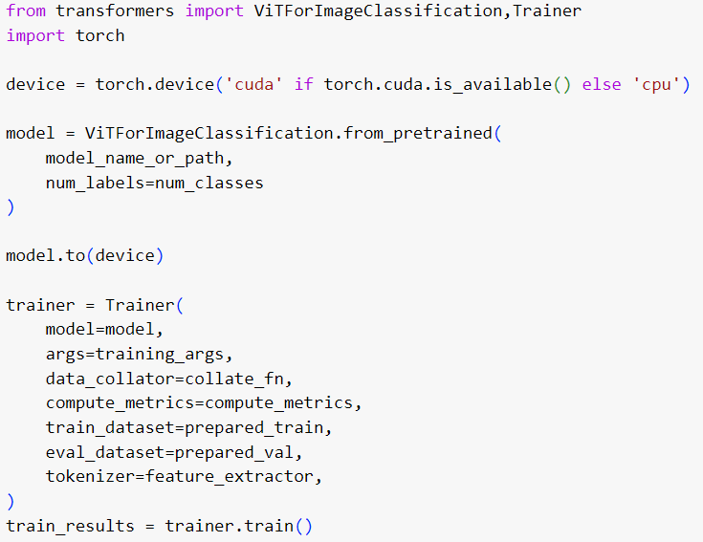
Model Training
Initialize the ViT for Image Classification.
Trainer manages the training process including data handling, model updates etc.
Model.to(device) moves the model to GPU if available.

Slide 23
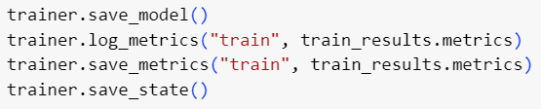
Model Training
Save the trained model and log metrics.
Save the state of model.

Slide 24
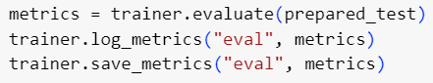
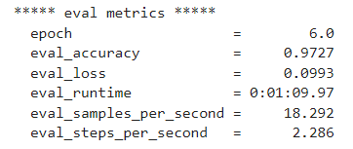
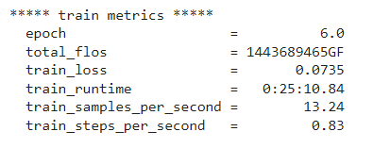
Evaluation and Prediction
Evaluate the model on the test set and log the metrics.
The model predicts the accuracy of 97.27%.
Evaluation Vs Training Matrices

Slide 25
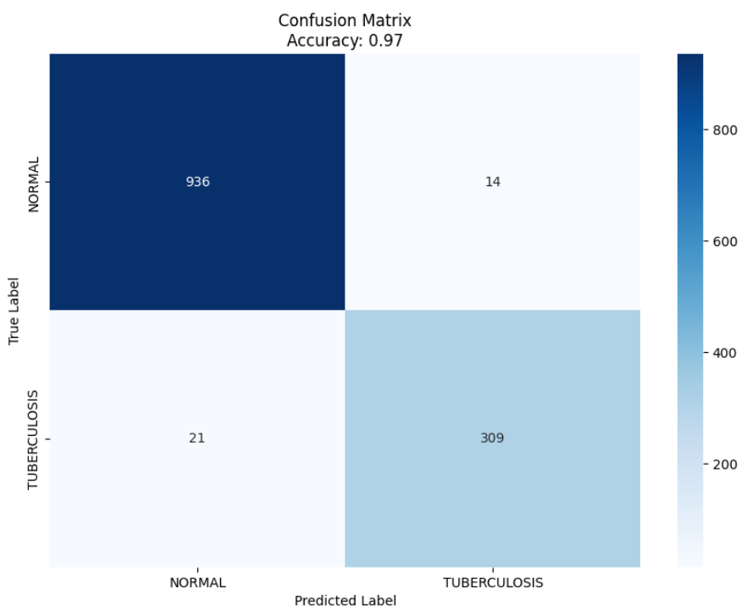
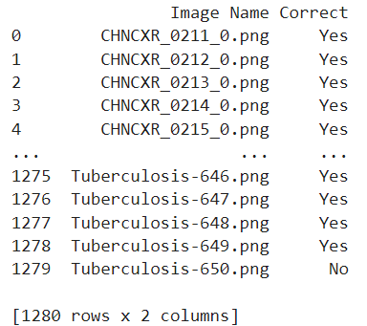
Evaluation and Prediction
The confusion matrix best describe the accuracy ratio of model.
We have added the data frame to predict whether the prediction is true or not.

Slide 26
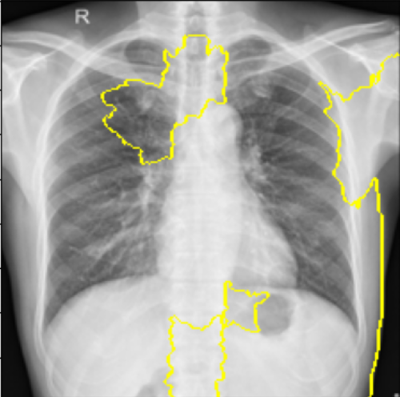
Explainability - LIME
(Local Interpretable Model Agnostic)
Generates explanations for the model’s predictions on the given image and visualizes the important regions that contribute in the result.

Slide 27
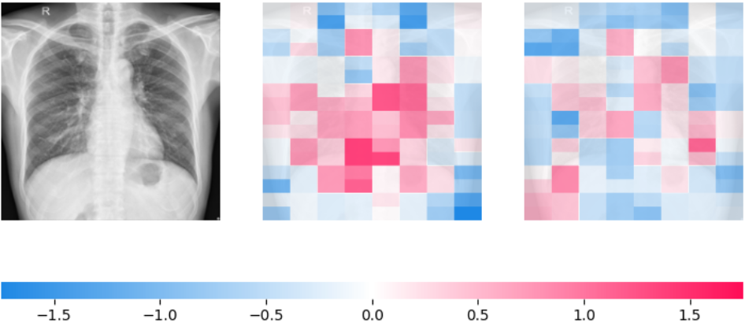
Explainability - SHAP
It is based on Shapley values from cooperative game theory and is designed to provide consistent and accurate feature importance scores
It generate heatmap to highlight the region.
Red → Positive Contribution
Blue → Negative Contribution

